Slide 1

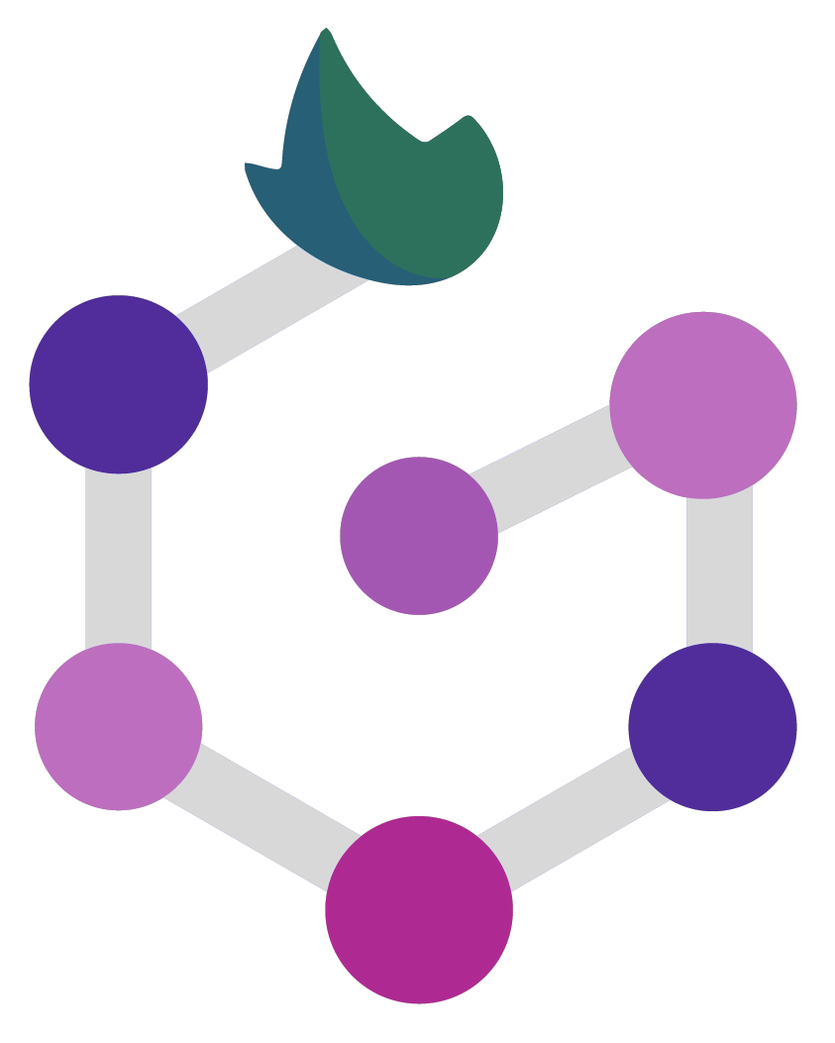

Handling data dependencies and inputs/outputs
Marco Di Marsico

Slide 2
Data Dependencies
Data dependencies are relationship between input and output files in a workflow;
Nextflow manages data dependencies by tracking the state of input and output files using a timestamp-based mechanism;
This approach ensures that only processes that require new or updated input files are executed, improving workflow efficiency.
Notes:
When we talk about data dependencies we refers to the relationship the are present between input and output. basically, nextflow uses directed acyclic graph to represent the dependencies, considering the inputs as the source node and the output as sink nodes. Each process is represented by a node and the edges between them represent the dependency. More over, nextflow utilize lazy evaluation model to manage data dependencies. this means that processes are only executed when their input data is available and output data is required by downstream processes. In this way, the workflow is executed in the most efficient manner and process executed only when necessary.

Slide 3
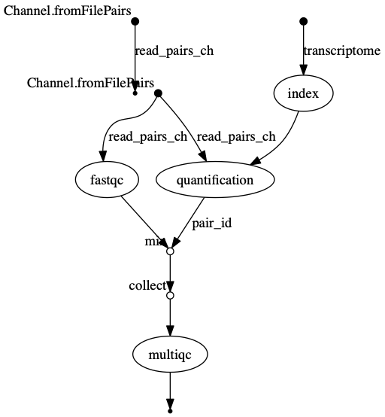
DAG graph
nextflow run -with-dag flowchart.png

Slide 4

File Tracking
File tracking is the process of keeping track of the state of input and output files;
Nextflow uses a timestamp-based mechanism to track input and output files, allowing it to determine whether a file has been updated or not.
Notes:
Refers to the ability of tracking the state of the input and output in workflows. Nextflow use a mechanism to determine whether a process needs to be executed or whether the output can be reused. The elements are automatically tracked by the system. So, nextflow can evaluate if an input has been changed since the previous execution. If not, it reuses the previous execution without executing again the process.
nextflow log
nextflow log job
nextflow log job -f hash,name,exit,status

Slide 5

Caching
Caching is the process of storing intermediate data generated by processes for reuse in future executions;
Nextflow uses a hash-based mechanism to cache intermediate data, allowing it to avoid re-computation and speed up workflow execution;
Caching can be customized inside process using parameters like cache.

Slide 6

Data Parallelism
Data parallelism is the process of distributing processing across multiple nodes to speed up workflow execution;
Nextflow supports data parallelism through channel-based parallelization;
Channel-based parallelization allows for flexible and efficient distribution of data processing tasks.

Slide 7
Input & Outputs
Inputs and outputs are the files that are used as input and generated as output by processes in a workflow;
Nextflow supports a variety of input and output formats, including text, CSV, JSON, and binary formats;
Input and output files can be specified using file paths or wildcards, allowing for flexibility in file selection;
Nextflow also supports input and output files from remote sources, including URLs.

Slide 8
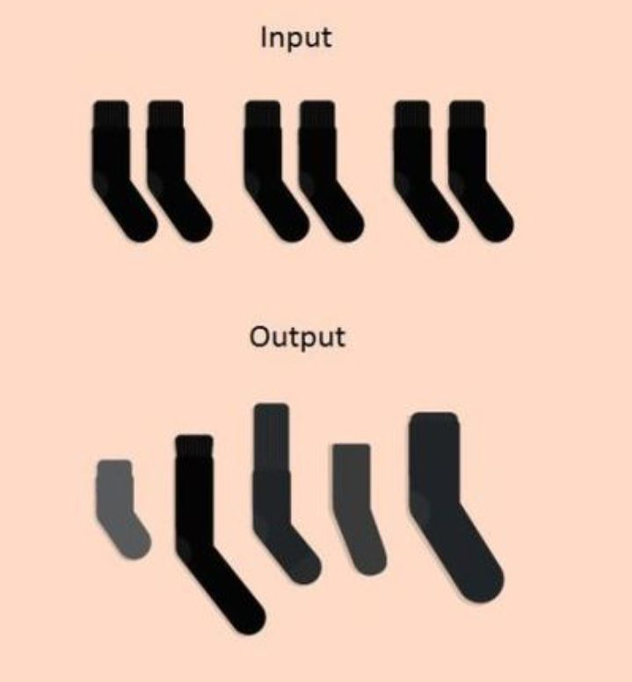
Input & Outputs

Slide 9
Input types
val accepts any data type;
path allows you to provide input files to the process execution context;
stdin forwards the input value to the process stdin special file;
each executes the process for each element in the input collection.

Slide 10
Output types
val emits the variable with the specified name;
path emits a file produced by the process with the specified name;
stdout emits the stdout of the executed process.

Slide 12
THANK YOU

